Slide 1
A Successful Scan Day at ZI
Plan Ahead and Avoid Common Problems
A User Introduction-Kathleen Durkin

Slide 2
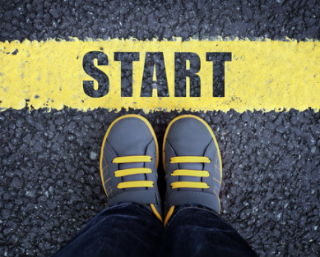
To Do in Advance: Overall Study Set Up
MR Safety training
Study IRB approval
Work with MR Physicist Amaresh Konar Shridhar to set up scan protocol
Get swipe card access to ZI
Run a pilot scan or two
Notes:
MR Technologist Jonathan Cardona jc5724@columbia.edu

Slide 3
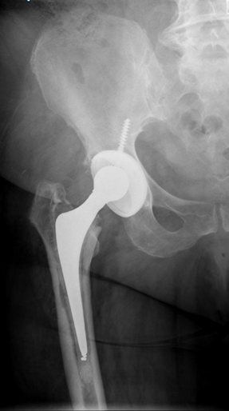
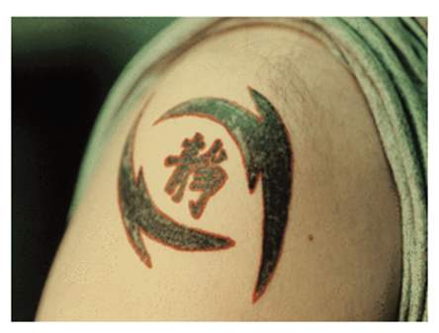
To Do in Advance: Pre-Scan Day Participant Prep
Select participant to be scanned.
Screen participant at least 48 hours in advance
Ask MR Technologist: all medical implants, all tattoos, all questions
Notes:
Thoroughly review the MRI safety questionnaire with participant PRIOR to their arrival.
If there is a questionable implant, please contact MRSO to clear patient for exam.
DO NOT WAIT UNTIL THE DAY OF EXAM
MRSO may not be available or will not be able to clear implant within the time frame you reserved.
If we don’t have this information, the participant can not be scanned. You will have wasted a scanning slot AND you will be billed.

Slide 4
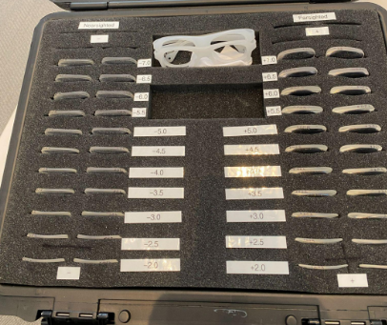
To Do in Advance: Pre-Scan Day Participant Prep
If there’s a functional task with a visual component, your participant may need vision correction. Before scan day, ask them:
-do you wear glasses or contacts?
-is it possible to wear contacts on scan day?
-if not, please bring your prescription if you have it
Notes:
If they did not bring their prescription you can narrow down the options with 2 questions:
1) Are you nearsighted or farsighted?
This answer will eliminate half of the lenses in the box.
2) Is your glasses prescription strong or do you just need a little correction?
This will either eliminate the stronger lenses (thick lenses, closer to the hinge on the case) or
the weaker lenses (thin lenses, closer to the case’s handle and latches.)

Slide 5
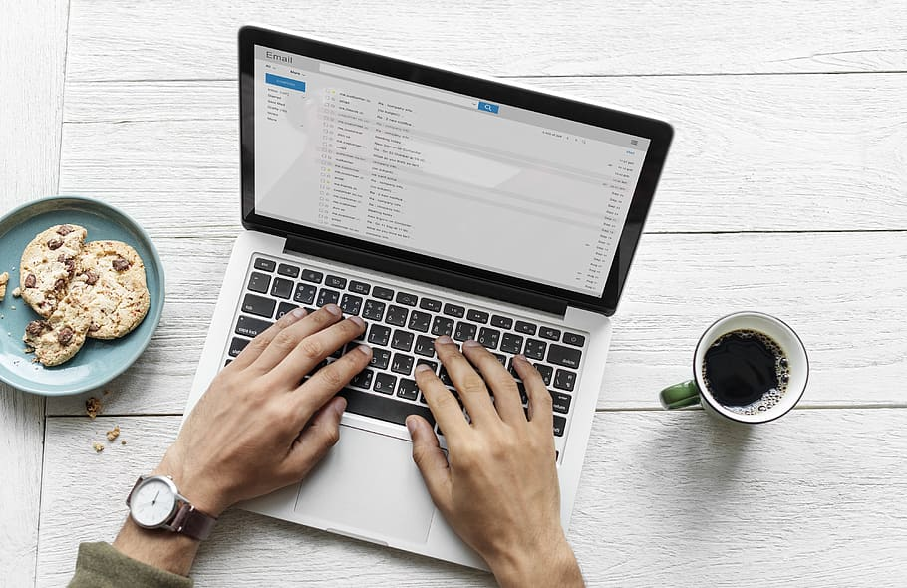
To Do in Advance: Pre-Scan Day Scheduling
Schedule the scan in iLab
Schedule time in testing room or mock scanner room, if needed
Send these details to the MR Technologist:
Participant Name
Arrival and Departure Time from ZI
Names of both researchers
Notes:
The MR technologist sends a list of all visitors (researchers and participants) to Security a day in advance. The researcher (you) must tell the MR Technologist all the names of people coming to the scan at least 48 hours in advance. Security has turned people away when this information was unavailable.

Slide 6

Reservation Time: How Long?
Reservation duration > MR image acquisition time
Reservation duration = acquisition time + setup + cleanup + troubleshooting
Be sure to reserve enough time to:
Set up participant (eye tracker calibration, testing button boxes, fitting eyeglasses, etc)
Troubleshoot or repeat a sequence if needed
Clean up
Notes:
Be sure to reserve enough time to:
Complete all necessary sequences
Safely set up patient with all ancillary equipment (button boxes, eyeglasses, eye tracking, etc)
Repeat a sequence if there is motion or they squeeze the alert ball
Stop and check with the safety officer if something goes wrong
The time it takes to complete the MRI is not all the time you need-you need set up time, troubleshooting time and clean up time.
If time might be tight, be aware of the priority the sequences (ask your PI) so you know which ones are absolutely essential to the study and which can be skipped, in case you run out of time

Slide 7

To Do in Advance: Pack for the Scan Day
Pack well. Bring everything you need:
laptop
screening form
consent form if needed
pregnancy test if needed, plus an extra
participant contact info
your Columbia ID
Make sure you have all the items you need.
Forgotten laptop chargers are our #1 equipment problem!

Slide 8
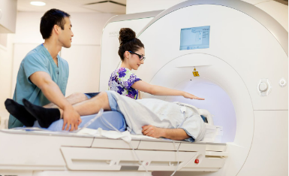
The Scan Day: the Team
Every MR scan that has a human participant requires at least 2 people present:
Level III certified MR system operator
Level III certified MR system operator or Level II safety trained scanner
There must be at least one Level III system operator. If no one in your lab is Level III, you’ll need to work with the ZI MR Technologist.
Notes:
Two researchers are required. It’s for your safety, and your participant’s safety.
If you recall our emergency procedures, most required simultaneous actions: get the participant out and call for help.

Slide 9
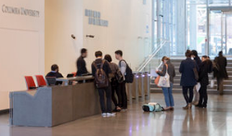
The Scan Day: Entry To ZI
A UNI
A Columbia ID
Swipe access to ZI. (If you lack any of the above, contact Kathleen Durkin before the scan day.)
A scan on the calendar
Notes:
Building access: this needs to be set up in advance for people who don’t already work in ZI. Kathleen can help.
A scheduled scan is needed to work in the MR spaces. Due to demand for time in the testing rooms and mock scanner rooms, researchers can only use these spaces on scan days.
MR users and MR participants should not use the Envoy check-in kiosks in the lobby. The database is not HIPAA protected so we don’t want participant names entered in them.

Slide 10

The Scan Day: Participant prep
Have the participant come to ZI before the reservation start time.
Meet participant in lobby. Bring them down to the scan areas.
Participant MUST change into scrubs.
Have them do a pregnancy test, if your IRB requires it.
Participant must remove all metal: watch, jewelry, all piercings, bra, everything. Underwear can stay on.
Notes:
Have the participant come in before the reservation starts so they can be changed, screened, and ready to go on time.
Participant MUST change into scrubs. No street clothes permitted. Some fabrics contain metallic fibers that can cause burns when exposed to the RF used to create the MRI image. These fibers will not be picked up by the metal detector wand. The only exceptions are children and pregnant people.
Pregnancy test script: “All right, this is a urine pregnancy test. We require it from all people with a uterus.” (Explain how it works, for example “Here’s a cup, and the test contains an eyedropper. Urinate in the cup and open the test. Use the eyedropper to place 3 drops of urine in the round well. Empty the cup in the toilet and toss it in the trash with the eyedropper. Wash your hands.”) Put on gloves while they're in the bathroom, and grab a paper towel. When they come out and hand it to you, wrap it in the paper towel, set it aside, remove your gloves, wash your hands, and set the timer on your phone. Check the test after the elapsed time. If negative, they’re good to do. If positive, do the test again. If both are positive, cancel the scan for the day and have them call their own doctor to get a test to confirm the pregnancy. Follow up with them in a few days to reschedule the scan if possible.

Slide 11
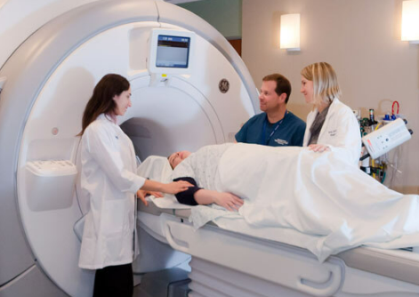
The Scan Day: Explain the scan to the participant
The headcoil
The functional task, response devices
Holding still
Earplugs
Communication during the scan: the squeeze ball, the intercom
Notes:
The headcoil “You’ll lie down on your back and set your head in a comfortable padded cradle. Another piece goes on top. The top pierce is kind of like the faceplate on a football helmet-- you can see through it, and it comes close to your face but does not touch your face. There will be a mirror angled so you can see outside the scanner.”
The functional task, button boxes
Holding still: “Even 2 mm of movement can ruin the picture, and then we have to take the picture again. That’s not a problem, but it takes longer. We’ll put a lot of padding around your head so it’s comfortable, but also to have just a bit of pressure to help you stay perfectly still. And let us know if anything is uncomfortable when we’re setting you up-- even a little bit uncomfortable. Small discomforts become big discomforts after 30 or 40 minutes.”)
Earplugs: “The scanner is very loud. So loud, it can cause hearing damage. So you’ll have to wear earplugs the whole time. We’ll still be able to talk and you’ll still be able to hear us. The earplugs only block the specific frequency of the noise that causes hearing damage.”)
Communication during the scan “(There’s an intercom system and we'll check in with you when it’s quiet. We won’t be able to talk when it’s noisy, but you’ll get a rubber squeeze ball. Anytime you want to say something or ask a question, squeeze the ball. We’ll hear a tone and stop the noise, then check in with you. Squeeze the ball if you feel uncomfortable, pain, heat, tingling, anything. Don’t wait for heat or discomfort to get bad; let us know right away. It could be letting us know there’s a problem, so don’t be a tough guy.”

Slide 12

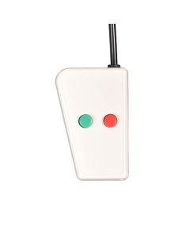
The Scan Day: Troubleshooting
Know how to reboot your laptop
Know how to reboot the scanner (instructions are on the desktop surface under the keyboard)
Know how to connect, test, turn on, and turn off all equipment you will be using
Bring all necessary equipment (laptop, chargers, etc) that you will need during the scan.
Notes:
Rebooting the scanner solves many problems but takes 10-15 min. Take the participant out and have them wait. Also email Kathleen to say you have to reboot so she can adjust your billing correctly.

Slide 13
The Scan Day: Reservation Changes
Participant late?
You can adjust your reservation ONLY if no one is right after you
Check the calendar.
If the time after you is available, cancel and rebook your scan WITH OVERLAP.
Problems? Email Kathleen Durkin to explain.
Notes:
Participant late?
It happens! You may be able to adjust your reservation, but ONLY if no one is right after you
You can edit or cancel a reservation in iLab up until its start time. After that, email Kathleen BEFORE ITS END TIME to make changes.
Check the calendar; is there time open after your scan?
If yes, cancel and rebook the scan WITH OVERLAP. Remember there must be 15 min between your scan and the scan after you.
No overlap? You can still cancel and rebook, but you will be billed for the scan AND the cancellation fee
Do not start at your original start time. Start at your new start time.

Slide 14

Study Name and IRB
Know the name of your study and the IRB associated with it.
It can be found on the consent form.
This will be helpful for working at the console, when navigating in Flywheel, and when creating the study record in REDCap.

Slide 15
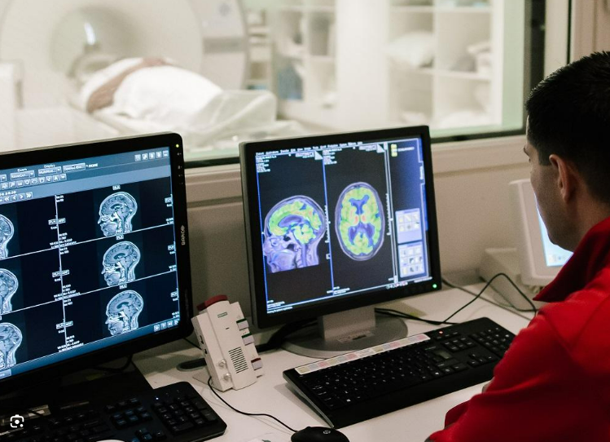
The Scan Day: During the Scan
Keep an eye on the participant’s motion.
Talk to them over the intercom occasionally.
If anything looks odd or seems unusual, call the MR Technologist Jonathan Cardona. (His phone number is posted at the scanner.)
Notes:
Keep an eye on the participant’s motion. If they need to hold more still, let them know. Offer more padding.
Check in over the intercom occasionally. “You’re doing great! The next scan will take 6 min.”
If anything looks odd or seems unusual, call the MR Technologist Jonathan Cardona.

Slide 16
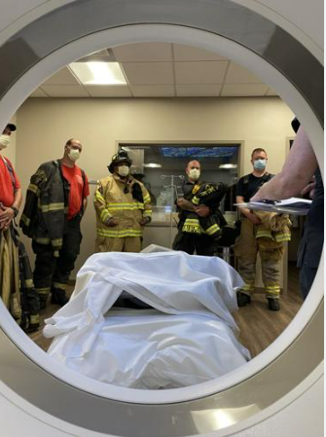
The Scan Day: Emergencies
Fire or medical emergency?
Get them out.
Make some calls.
All emergency procedures are printed and in the “Emergency Procedures” binder in the control room, on a shelf by the white box.
All emergencies: Call the MR Technologist Jonathan Cardona as soon as possible. (His phone number is posted at the scanner.)

Slide 17
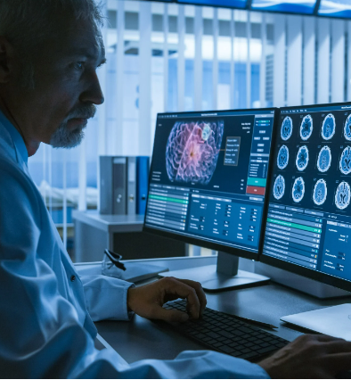
The Scan Day: Post-Scan Procedures
After scan:
Help participant out of the scanner. Have them change back into their own clothes and put their metal back on.
Walk them up to the lobby.
Return to scanner. Send anatomical files to Radiology to be read for incidental findings. (Instructions are on the desktop surface under the keyboard.)
Create a REDCap record so the radiologists know to read for the new images.
Notes:
Help participant out of the scanner. Have them change back into their own clothes and put their metal back on.
Walk them up to the lobby. We can’t have non-ZI people getting lost in the building.
Return to scanner. Send anatomical files to Radiology to be read for incidental findings (instructions are on the desktop surface under the keyboard). This will get read in 2 weeks but usually faster. We highlighted this part because it’s easy to forget, at the end of the scan, but very important.
Create a REDCap record so the radiologists know to read for the new images. We highlighted this part because it’s easy to forget, at the end of the scan, but very important. The participant ID has to be absolutely the same as it was entered into the scan console. No variation at all. Otherwise, the radiologist wastes their time and the image doesn’t get read. And it is YOUR job to check the REDCap record over the next two weeks to find the radiologist report. Always read the report. If the participant needs to be told about a potentially medically important finding, the website can tell you the next steps: https://mr.research.columbia.edu/sites/default/files/content/Docs/Incidental%20Findings%20Checklist%20and%20Levels.pdf

Slide 18
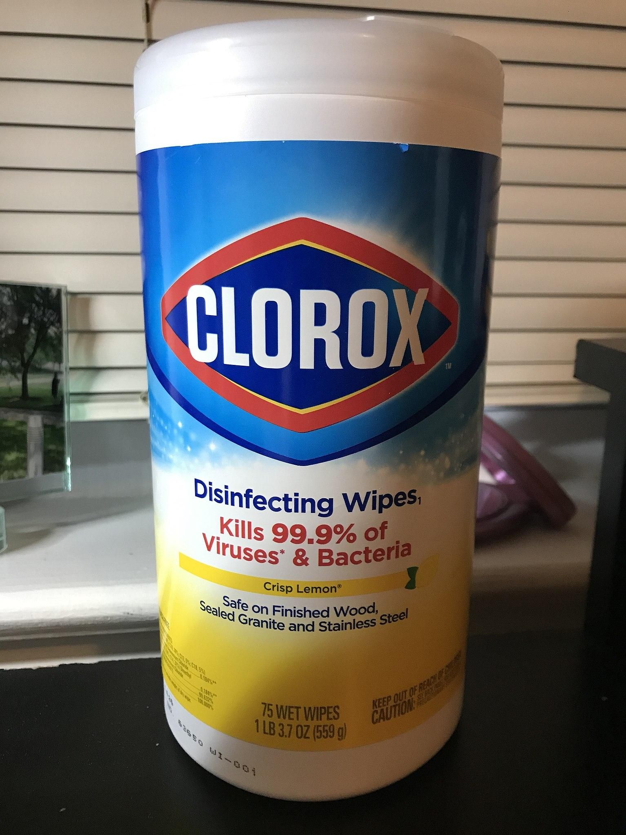
The Scan Day: Post-Scan Cleaning
After scan, make sure:
Clean ALL surfaces that were used/touched in MRI scanner room, console room and patient prep area.
There should be at least 15 minutes between the end of your scan and the beginning of the next.
Fill out Post Scan Cleaning checklist and file in room.

Slide 19

Great job! You had a successful scan day.
Now you get to analyze the data.

